Slide 1


No More Error 404!
KIET Group of Institutions, Muradnagar-201206

Slide 2
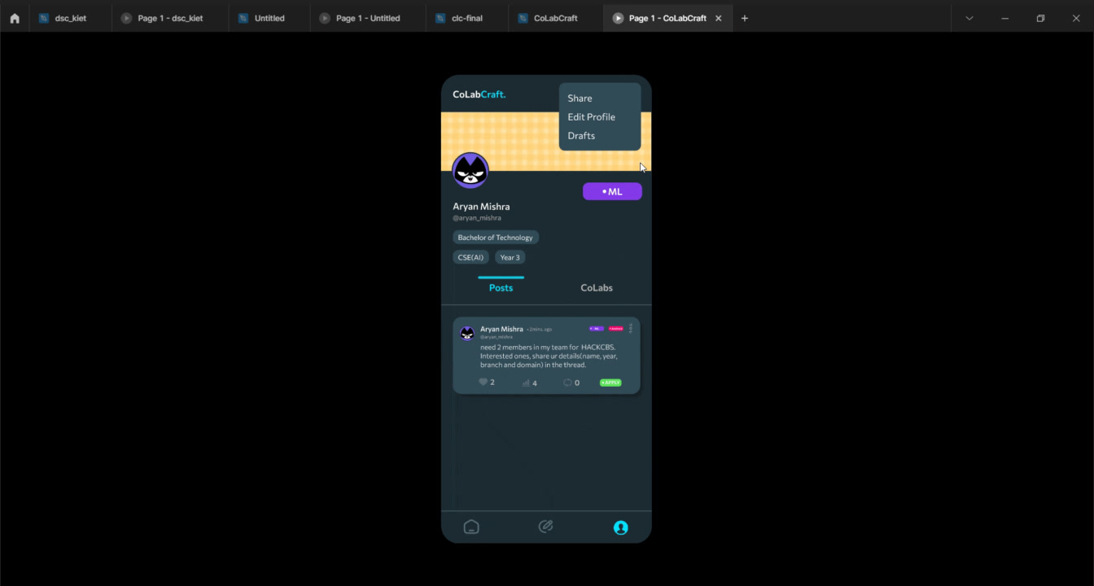

Slide 3

PROBLEMS
?
Fragmented Coordination:
Lack of a centralized system for students to coordinate and find like-minded individuals.
Inefficient Communication Channels:
Existing communication methods (notice boards, social media) are fragmented and not optimized for team formation.
Limited Visibility:
Traditional methods such as posters and notice boards have limited reach and visibility.
Missed Collaborative Opportunities:
Lack of a streamlined process results in missed opportunities for students to form diverse and effective teams.

Slide 4
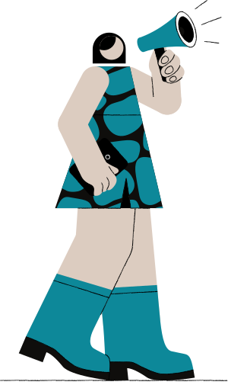
SOLUTION
Centralized Team Formation:
Feature: Introduce a user-friendly platform allowing students to create profiles.
Enhanced Visibility:
Feature: suggest potential team matches through Tags.
Efficient Team Building:
Feature: Incorporate a team based on skills and preferences.
Post Your Requirements:
Whether you are a team member already or looking for a team, you can always post any requirement and let people interested reach you.

Slide 5

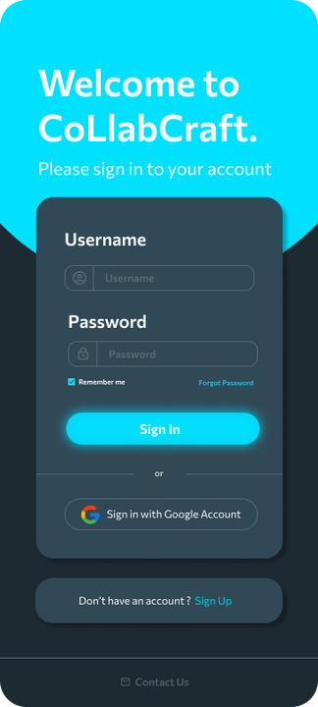
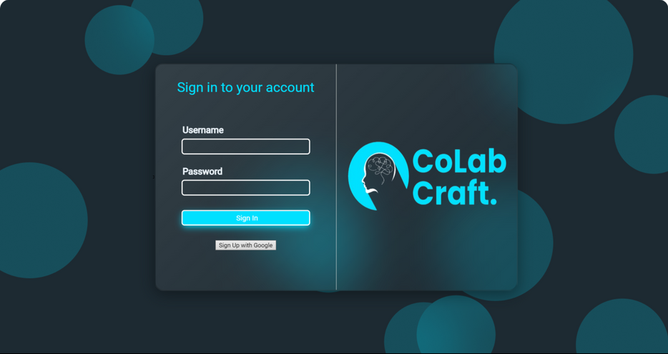





PRODUCT/SERVICE
CoLabCraft will be available as both an android app and a website to all of its users
Students will be able to post their requirements in a thread like format similar to twitter
Students will be able to directly send applications to teams in need of members
Every team will be able to easily track it’s team members and find new ones

Slide 6

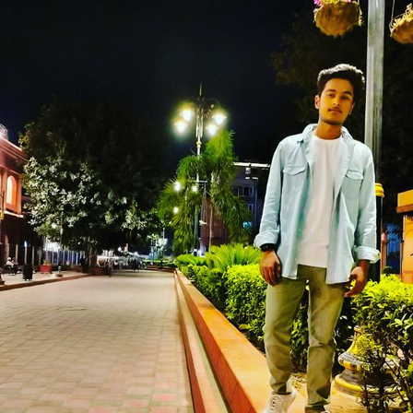
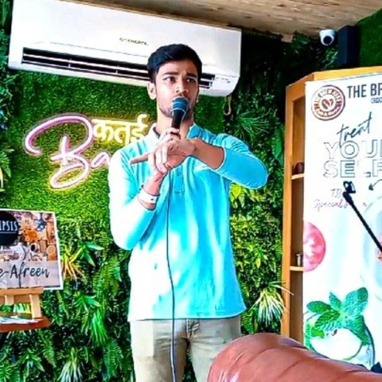
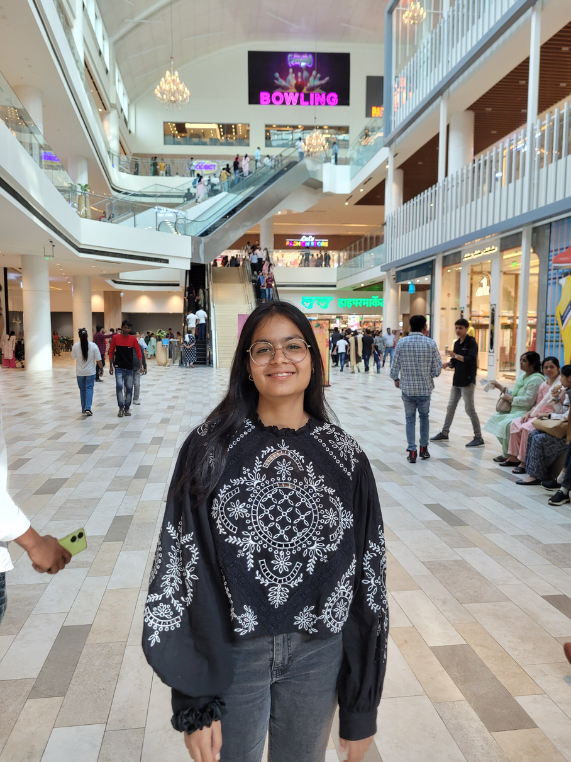
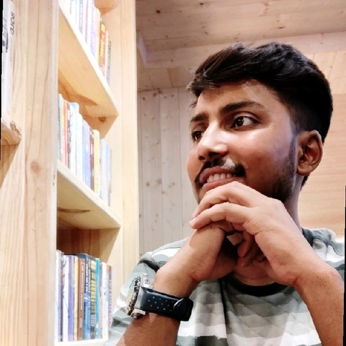
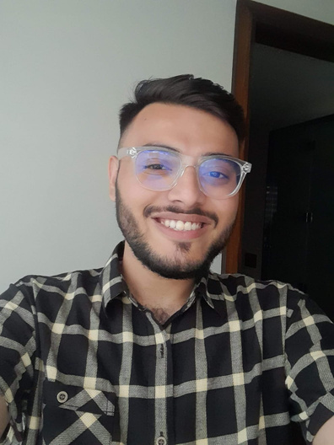
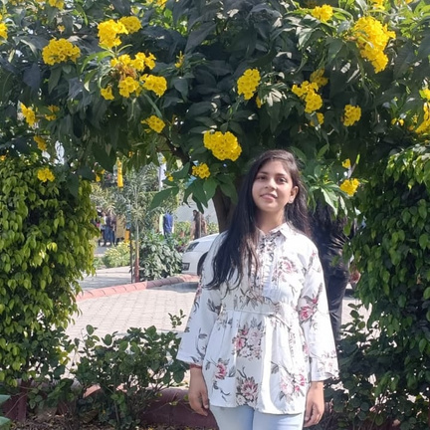
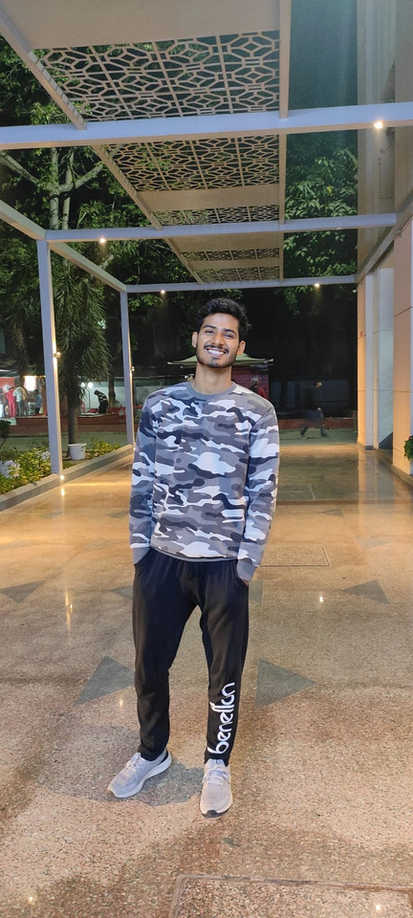


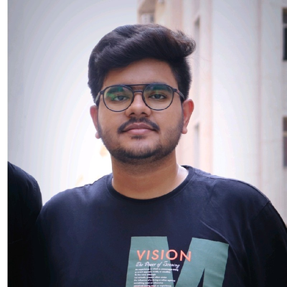

Meet the Team
Aniket Trivedi
Vaishnavi Verma
Ajeesh Rawal
Ayush Pratap
Ansh Singh
Aniket Ray
Avantika Sharma
Aryan Mishra
Ex-SDE Intern @BrahmGAN
Co-founder @DevUp
Core @Innogeeks
CSE (AIML)'25 @KIET
MENTOR

Slide 7



